Slide 1
Being agile with modern Java

Slide 2
Being agile?

Slide 3
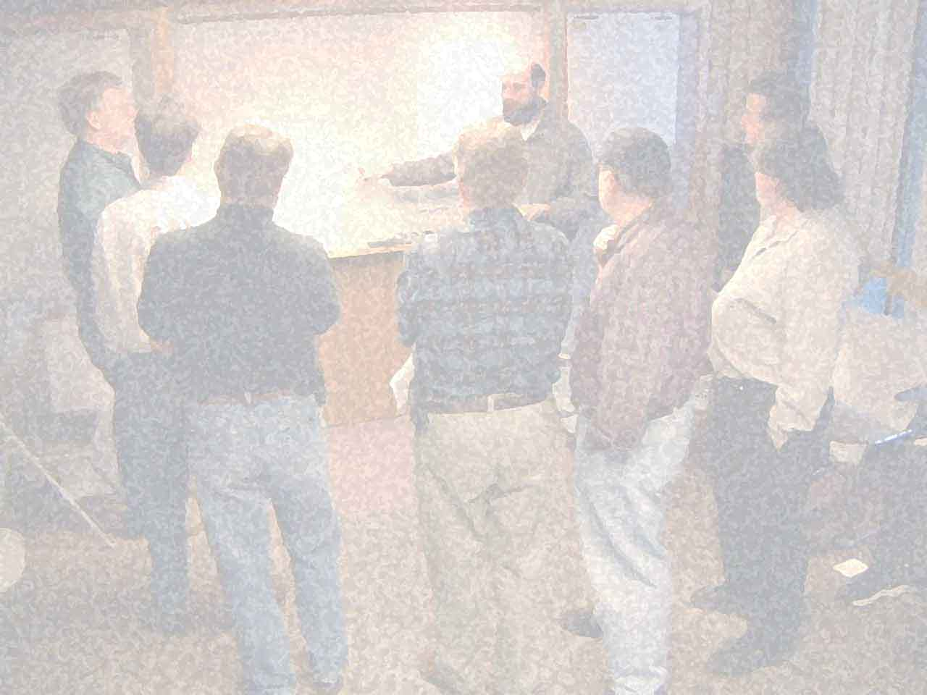

Slide 4
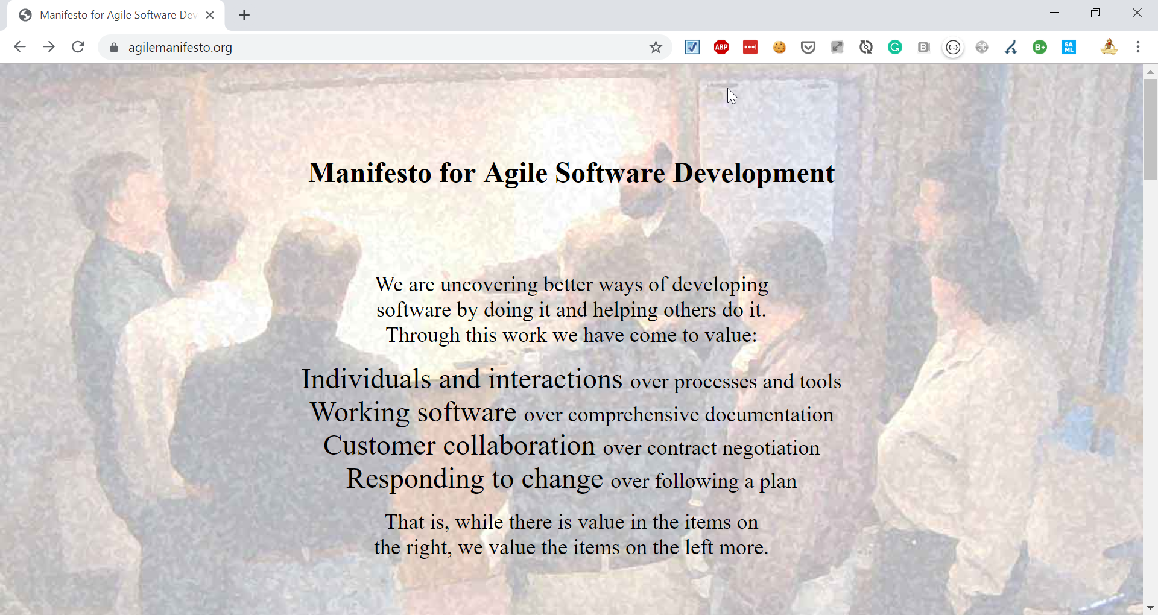
Notes:
JOKE: Old school HTML

Slide 5






(… at that time)
PROBLEMS

Slide 6
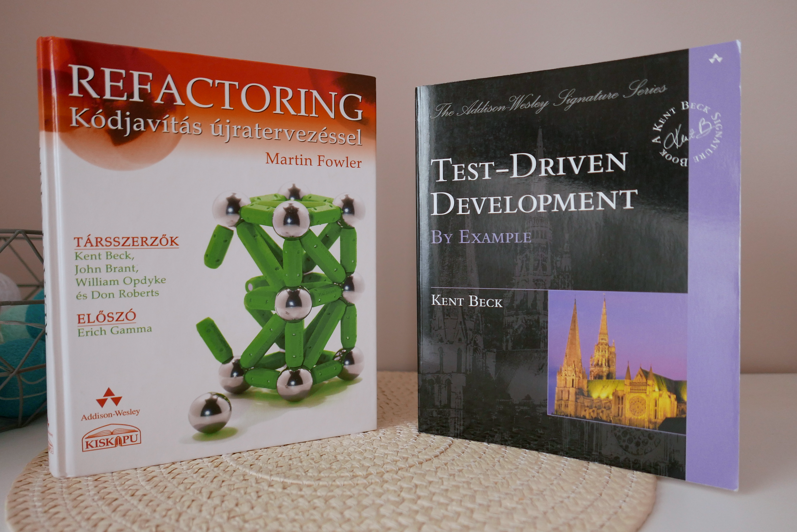

Slide 7
Being agile?

Slide 8
Thinking agile?

Slide 9
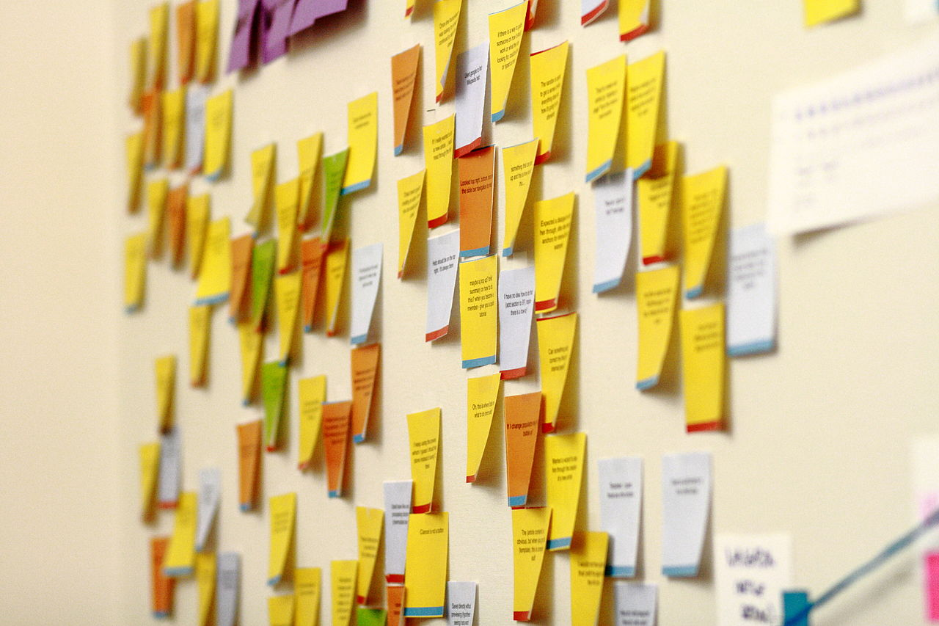

Slide 10
continuous optimization
simplification
small iterations
small experiments
AGILE
baby steps
stabilization
Notes:
EXAMPLE: Refactoring & TDD are using these approaches

Slide 11
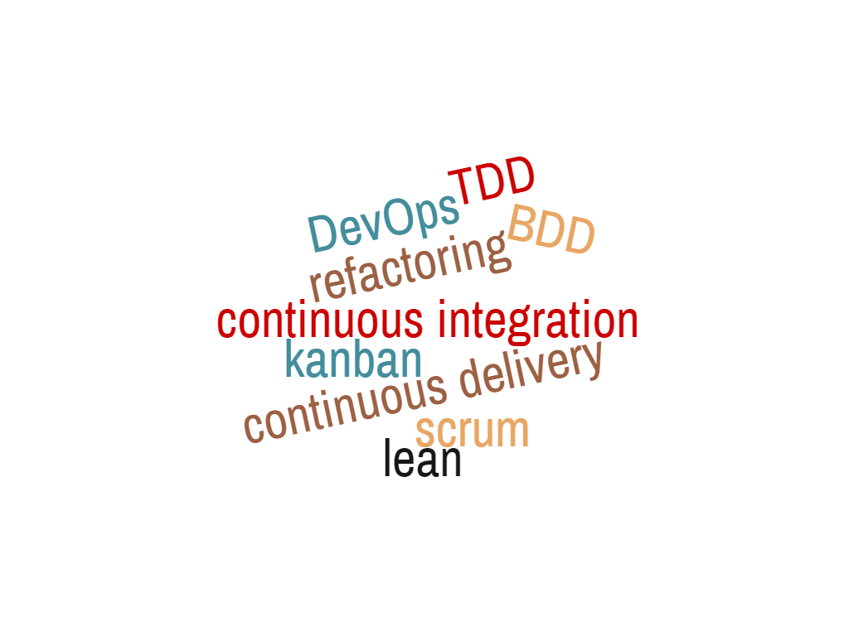
SAME APPROACH
Notes:
Example – how you can improve slow deployments
Word Cloud:
1 continuous~integration
1 continuous~delivery
1 refactoring
1 kanban
1 DevOps
1 scrum
1 lean
1 TDD
1 BDD

Slide 12
CI

Slide 13
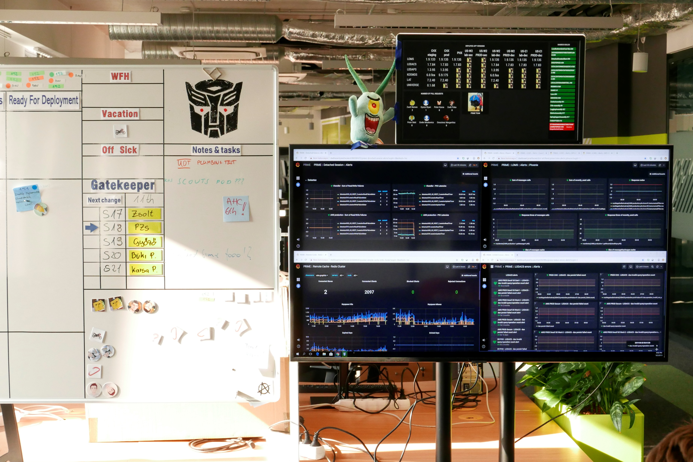
CI

Slide 14
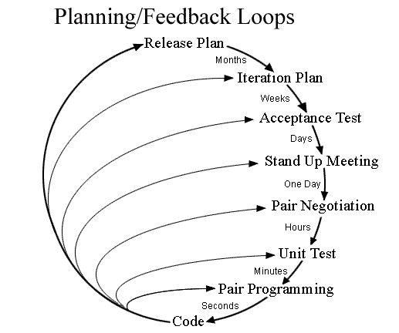
Notes:
Switch to faster feedback, when doubts: pairing

Slide 15
pipeline as code
living documentation
continuous testing
generators
containers
hotswap
code

Slide 16
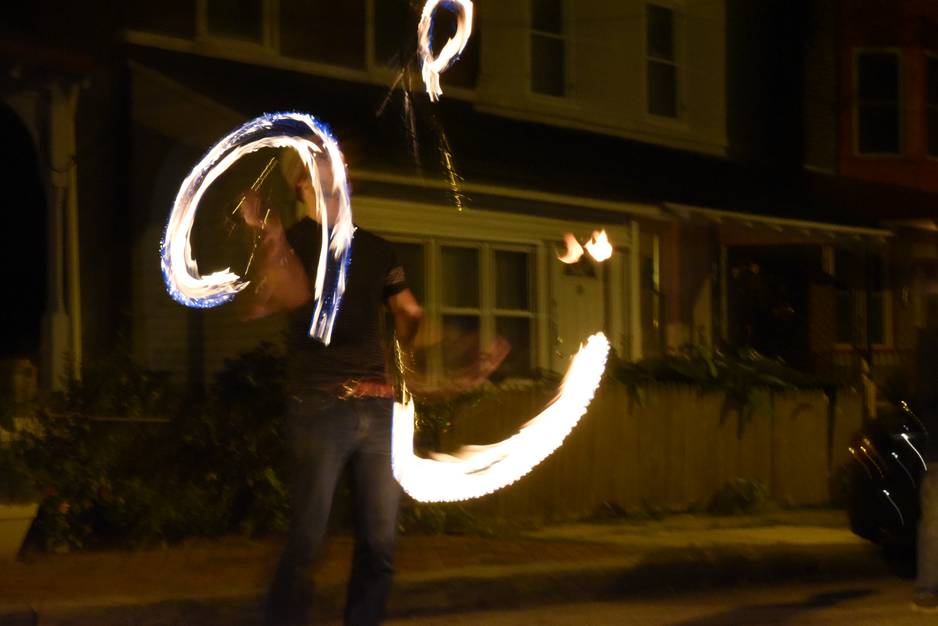
HOTSWAP

Slide 17
Ctrl+F9
Notes:
Works with Node.JS, Angular, Spring Boot, Play FW, Jhipster

Slide 18

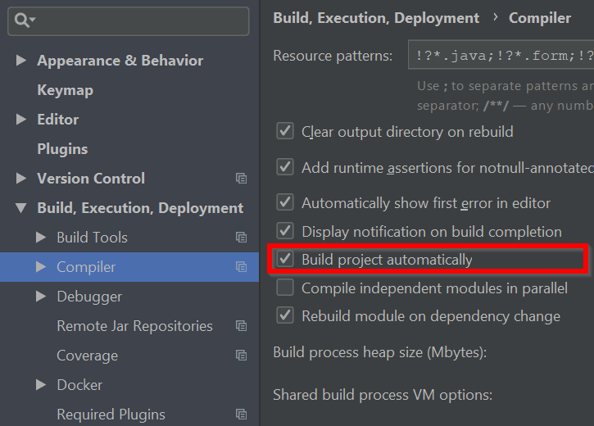
Notes:
Agile: simplification, small experiments, continuous optimization, baby steps
Metrics: fast feedback, usability, simplicity

Slide 19
0 cost
1st thing to do
don’t block hotswap
hotswap the whole day

Slide 20

CONTAINERS

Slide 21
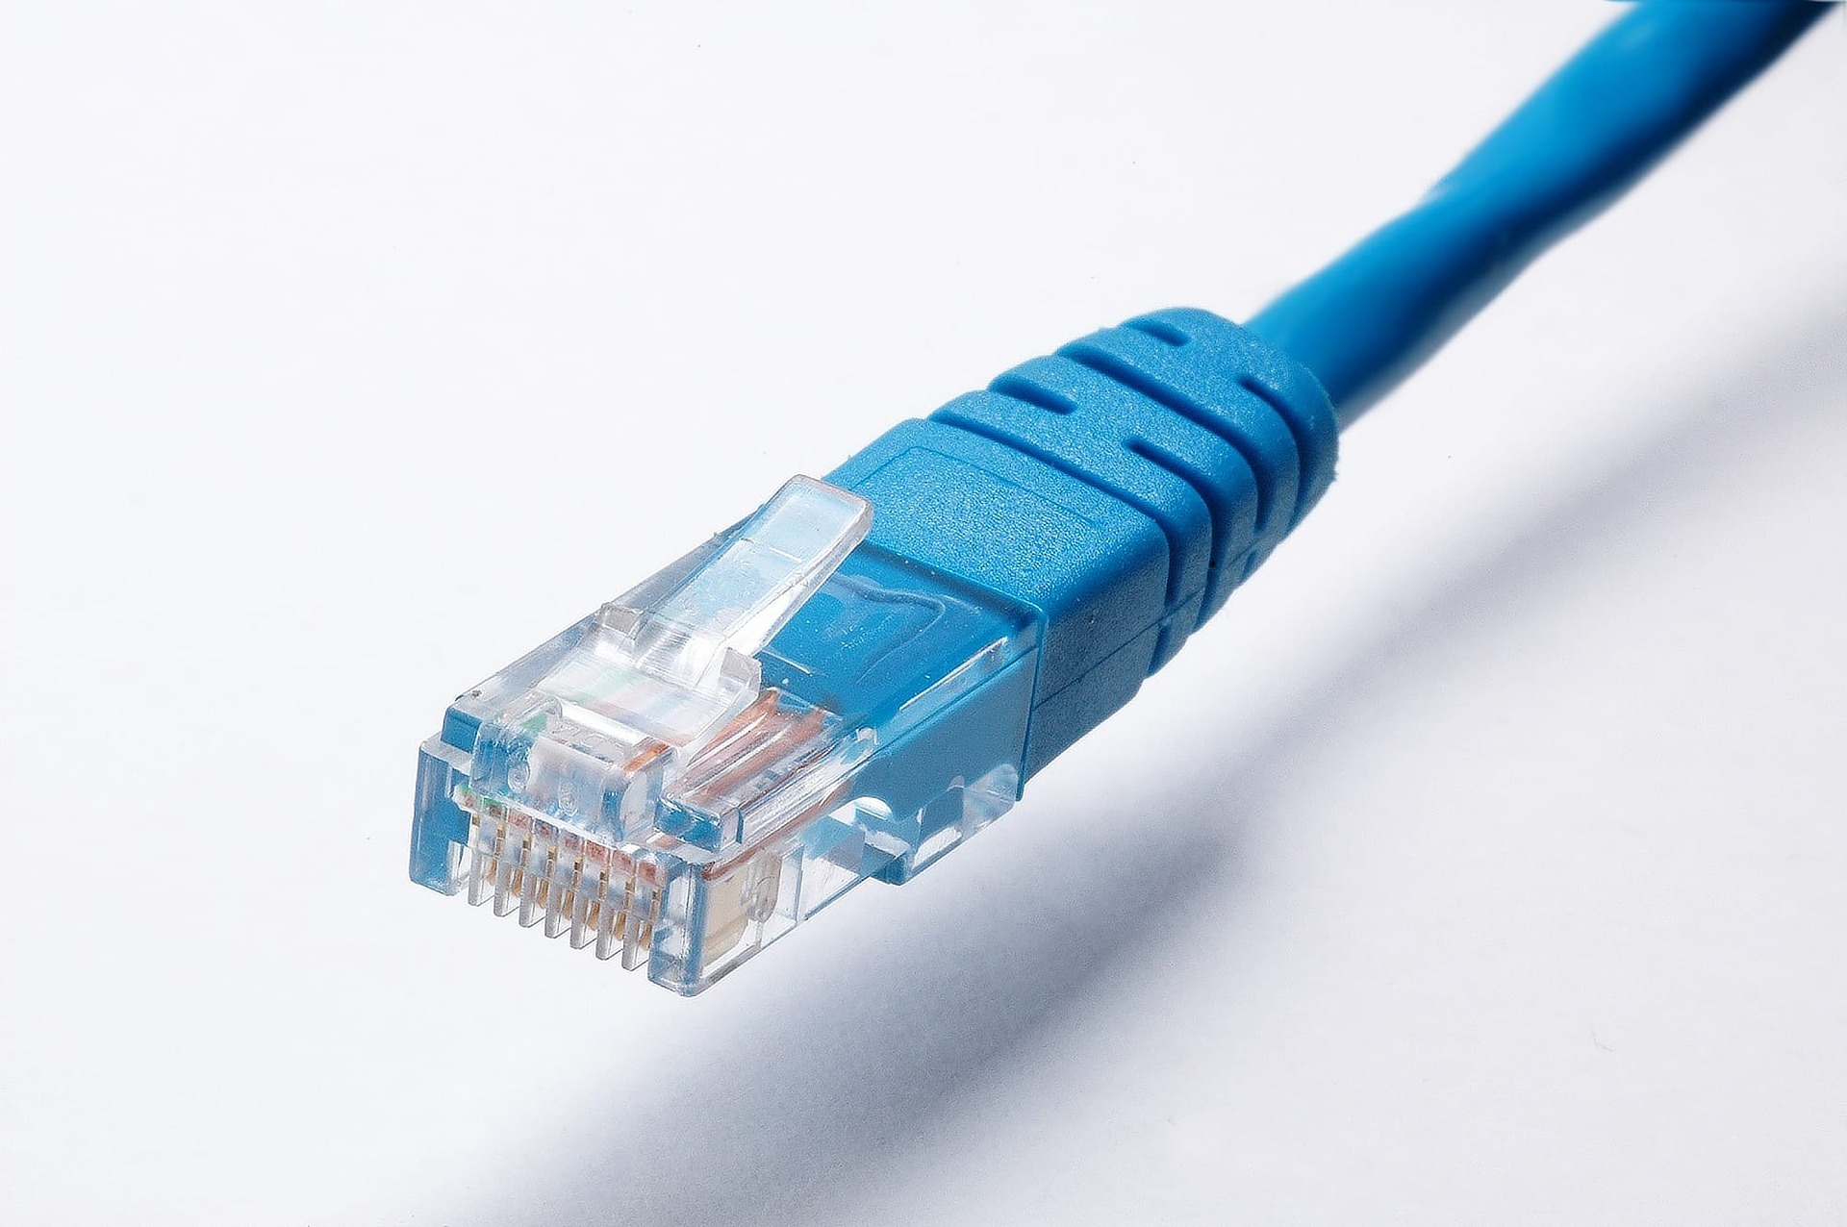

Slide 22








SAML 2.0
S3

Slide 23


VS
Notes:
3 seconds and 30 seconds make a difference

Slide 24
apiVersion: apps/v1
kind: Deployment
…
spec:
…
template:
spec:
containers:
- name: …
…
---
apiVersion: v1
kind: Service
metadata:
name: mysql
…
version: '3'
services:
toxiproxy:
image: "shopify/toxiproxy"
redis-master:
image: "redis:alpine"
redis-slave:
image: "redis:alpine"
mysql:
image: mysql:5.6
…

Slide 25



Slide 26

plugins { id 'com.google.cloud.tools.jib' version '1.4.0’ }
./gradlew jibDockerBuild \
--image=agile-springboot:latest

Slide 27
apiVersion: skaffold/v1beta13 kind: Config build: artifacts: - image: agile-springboot deploy: kubectl: manifests: - src\main\kubernetes\agile-springboot.yml - src\main\kubernetes\mysql.yml
eval $(minikube env)
skaffold init
skaffold dev
Notes:
Agile: simplification, small iterations, small experiments, stabilization
Metrics: no snowflakes, no S.P.O.F, usability, fast feedback, simplicity

Slide 28
fastest orchestrator locally
use embedded dependencies if needed
don’t depend on your orchestrator
dependencies living documentation
don’t block hotswappin’

Slide 29
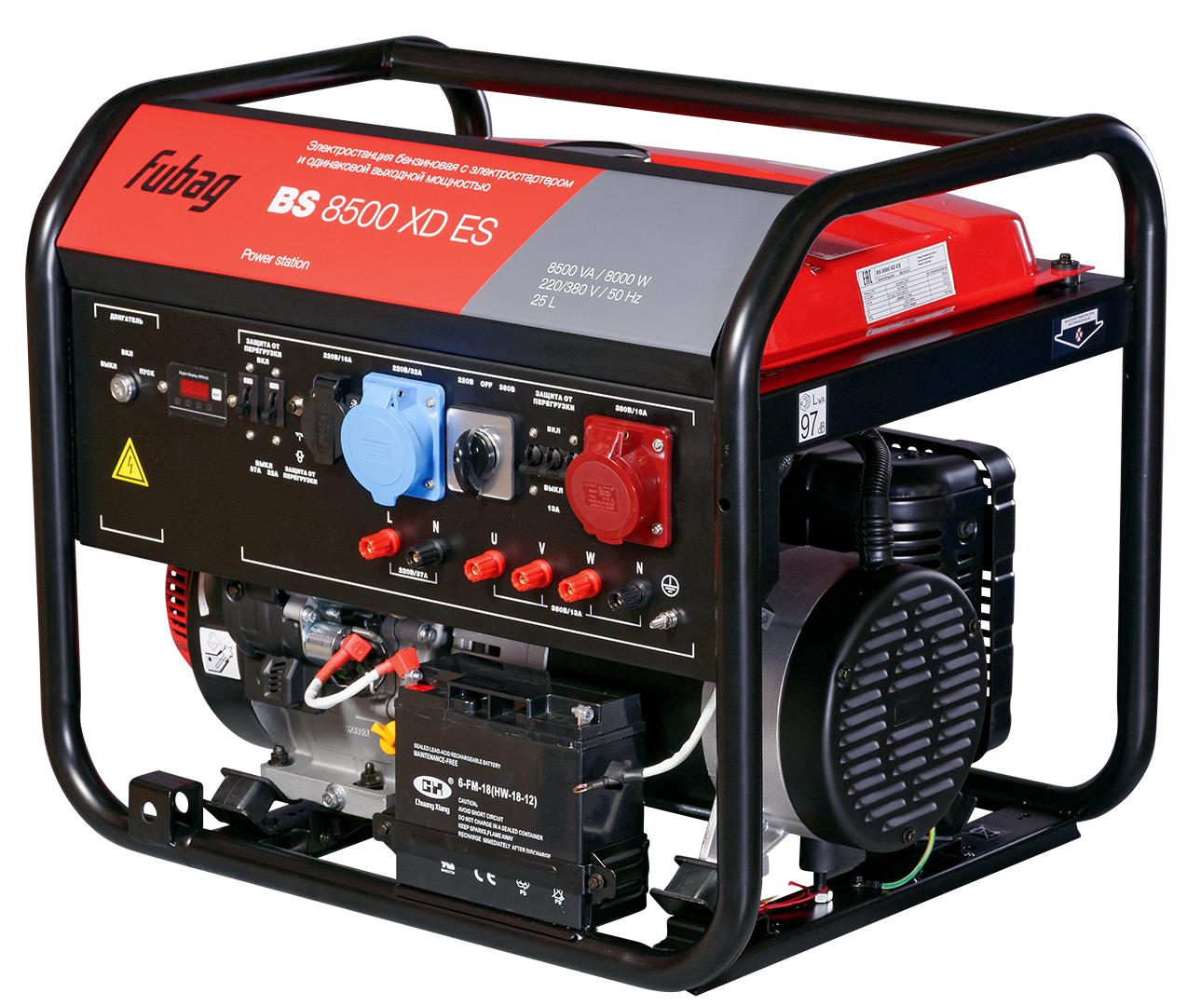
GENERATORS

Slide 30
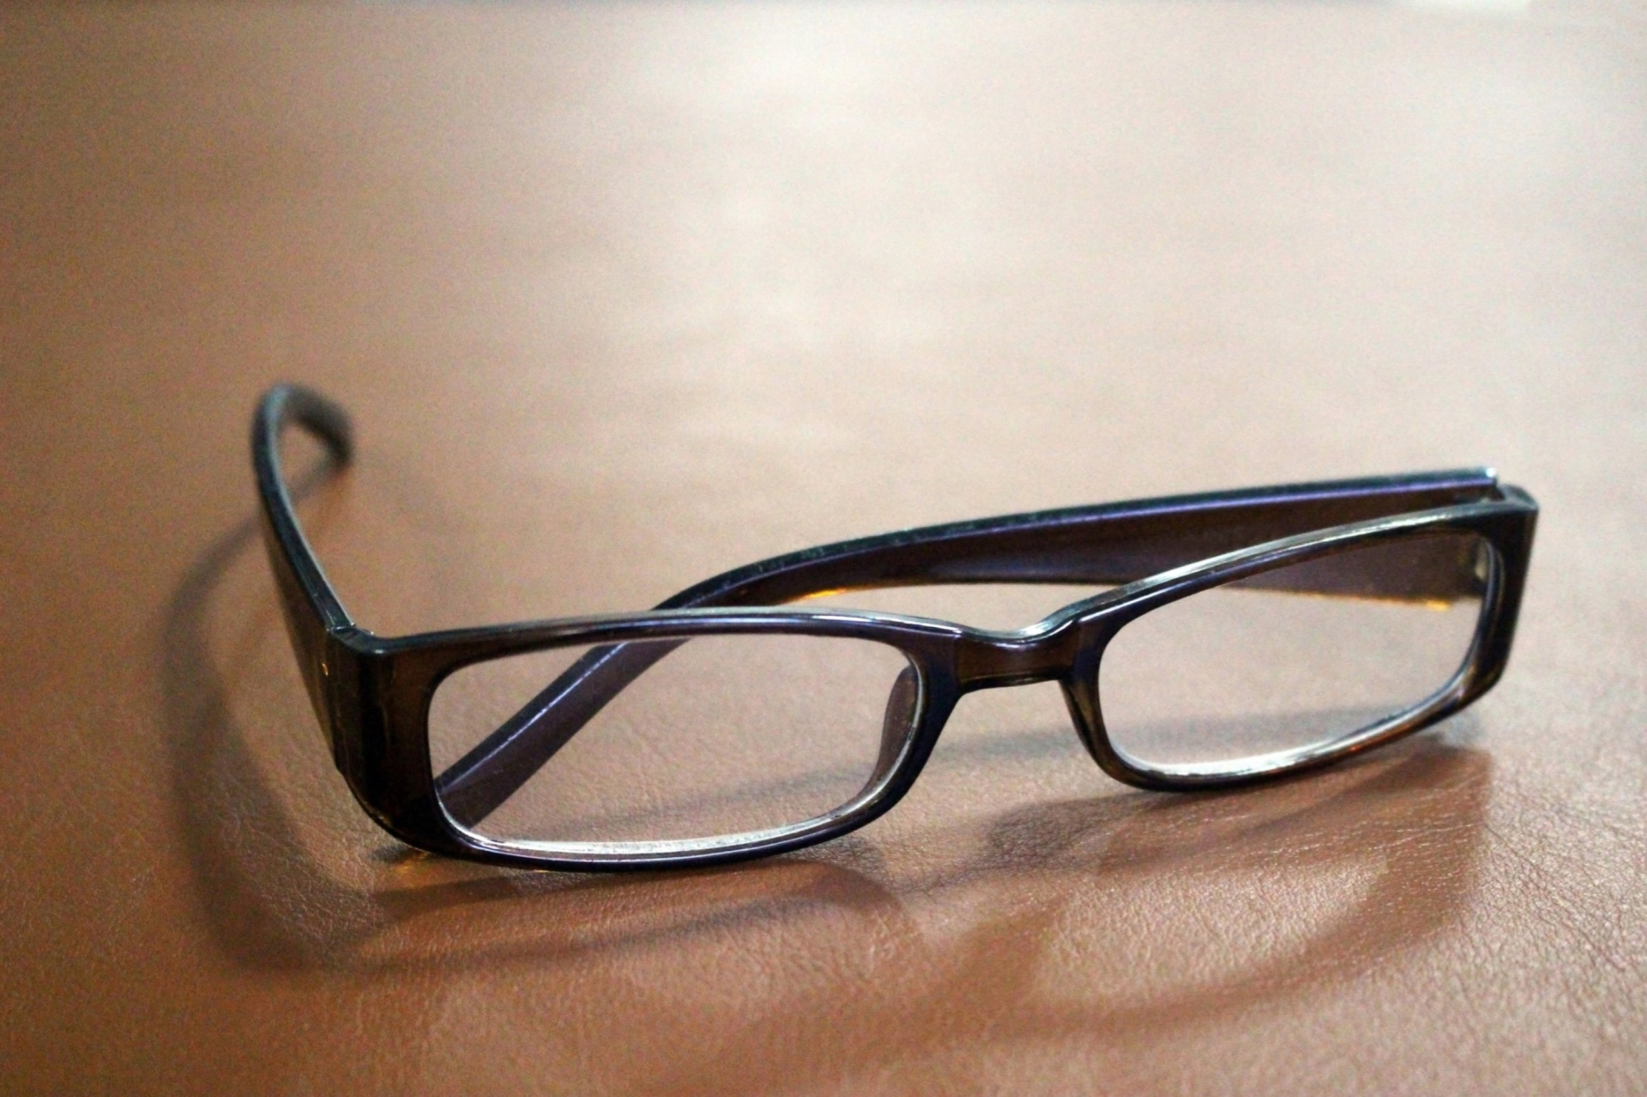
CODE READING

Slide 31
CODE
=
DOMAIN

Slide 32



lombok

Slide 33
@Data @Entity public class Person { @Id private Integer id; private String firstName; private String lastName; }
@NoArgsConstructor public class LegacyPersonDTO { @Getter @Setter private String fullName; }

Slide 34
@Mapper public interface PersonToPersonDTOMapper { @Mapping(target = "fullName", expression =
"java(person.getFirstName()+\" \"+person.getLastName())") LegacyPersonDTO personToLegacyPersonDTO(Person person);
}

Slide 35
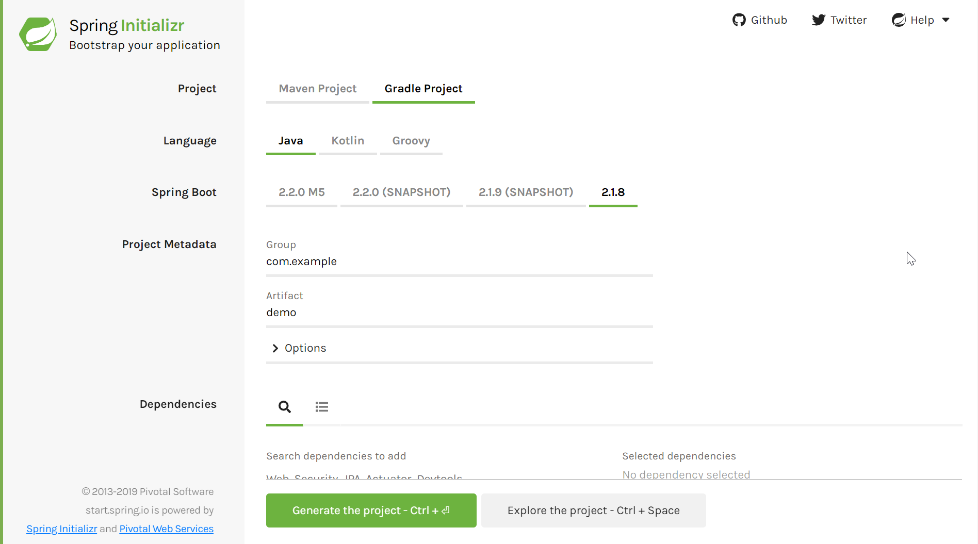

Slide 36
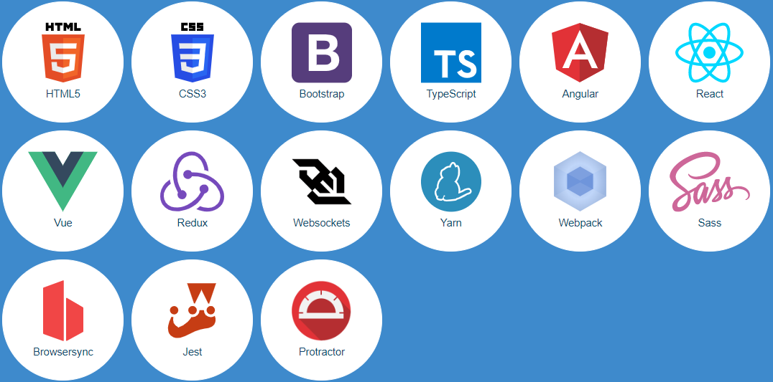
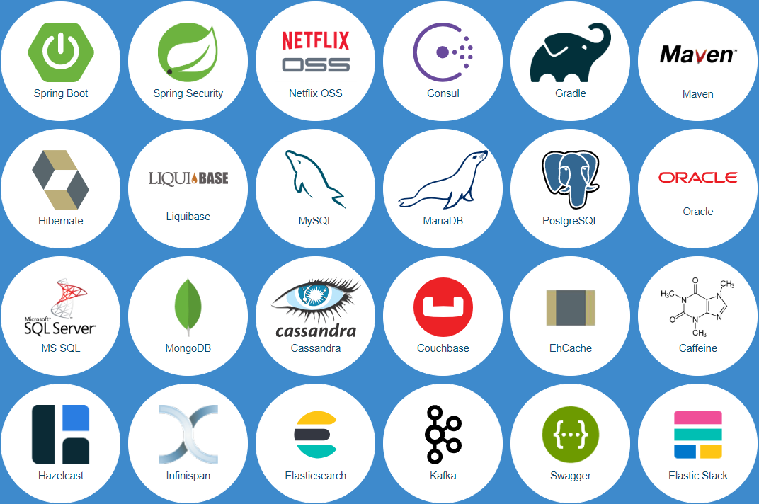

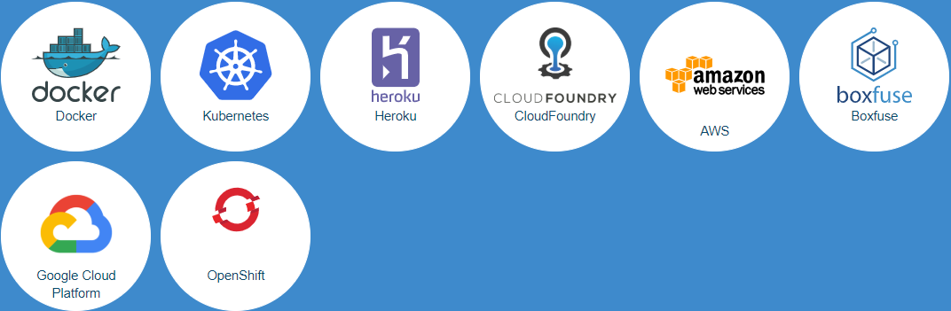


Slide 37
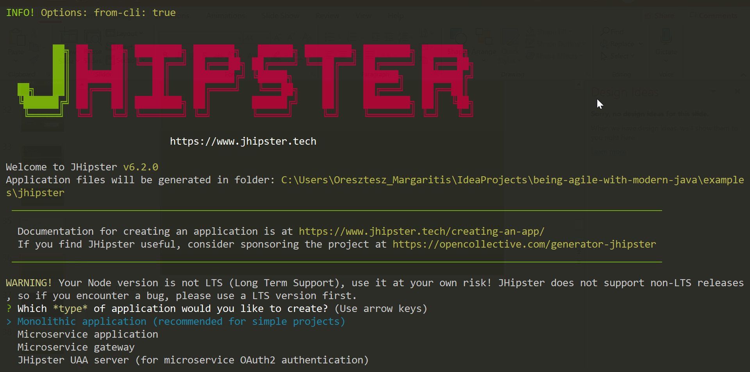

Slide 38
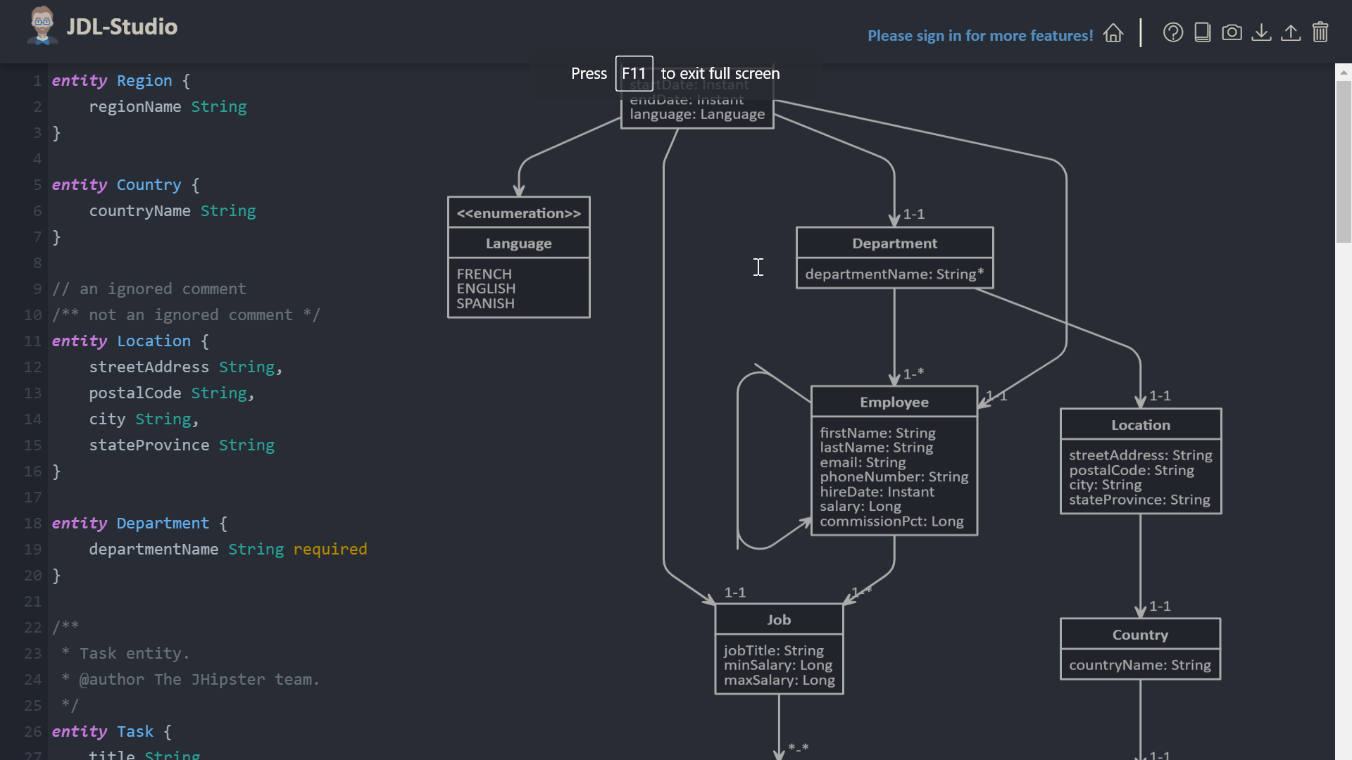
Notes:
Agile: simplification, small experiments, small iterations, baby steps
Metrics: simplicity, feature richness, usability

Slide 39
read less, write more
application runs from day 1
avoid stuck in re-generating everything

Slide 40

CONTINUOUS TESTING

Slide 41
MANUAL
END-TO-END
INTEGRATION
UNIT

Slide 42
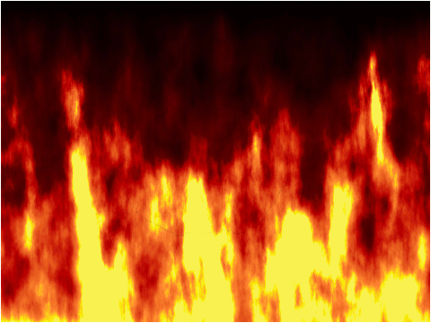

MANUAL
INTEGRATION
UNIT
END-TO-END
DEV
QA

Slide 43


Mocha
Grinder
Selenium
JUnit
PyTest
Gatling
JMeter

Slide 44
@Test public void testGetPerson() throws IOException, InterruptedException { var getPersonRequest = HttpRequest.newBuilder() .uri(URI.create("http://localhost:8080/person/1")) .timeout(Duration.ofSeconds(10)) .header("Content-Type", "application/json") .build(); var getPersonResponse = HTTP_CLIENT.send(getPersonRequest, AS_STRING); Assert.assertEquals(200, getPersonResponse.statusCode()); Assert.assertTrue(getPersonResponse.body().contains("firstName")); Assert.assertTrue(getPersonResponse.body().contains("lastName")); }

Slide 45
--- execution: - executor: junit concurrency: 20 hold-for: 2m scenario: script: src/test/java reporting: - module: final-stats - module: console - module: passfail criteria: - avg-rt of testGetPerson>50ms for 10s, stop as failed - p99 of testGetPerson>120ms for 5s, stop as failed - fail of testGetLegacyPerson>50% for 10s, stop as failed modules: junit: compile-target-java: 11

Slide 46
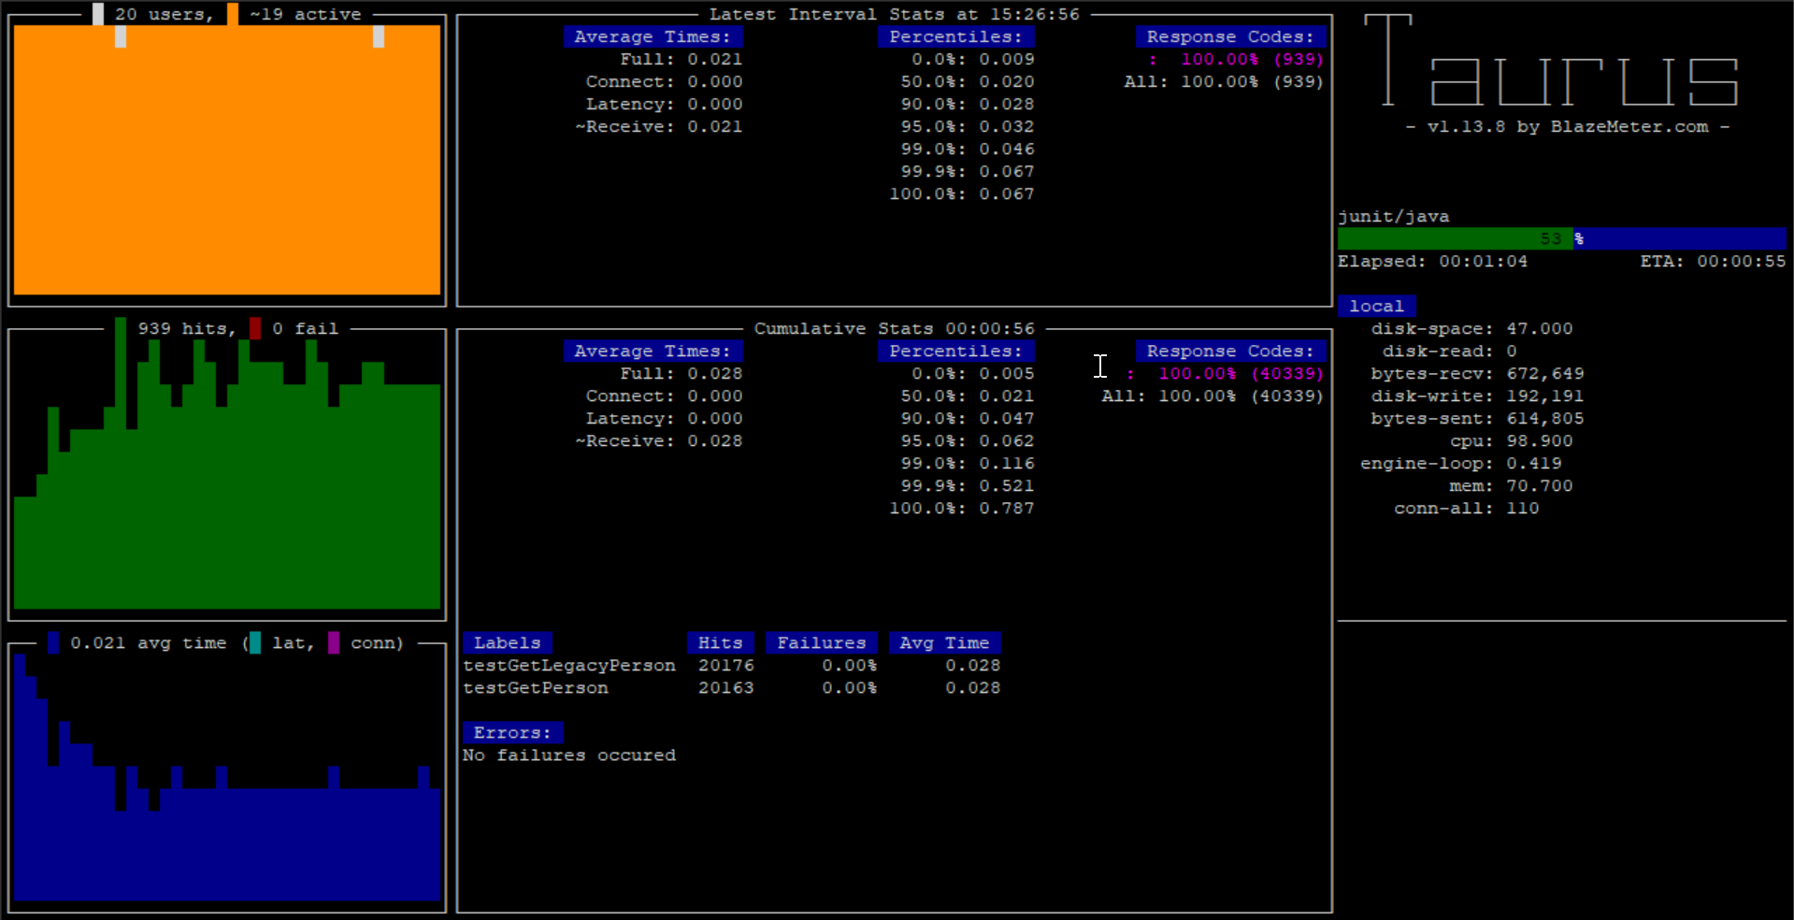
Notes:
Agile: simplification, stabilization, continuous optimization, small iterations, small experiments
Metrics: simplicity, fast feedback, usability, feature richness, no snowflakes

Slide 47
same review for all tests
use common language
re-use test cases
cheap high-level tests

Slide 48

LIVING DOCUMENTATION

Slide 49
/** * Feature that determines whether generator will automatically * close underlying output target that is NOT owned by the * generator. * If disabled, calling application has to separately * close the underlying {@link OutputStream} and {@link Writer} * instances used to create the generator. If enabled, generator * will handle closing, as long as generator itself gets closed: * this happens when end-of-input is encountered, or generator * is closed by a call to {@link JsonGenerator#close}. *<p> * Feature is enabled by default. */ AUTO_CLOSE_TARGET(true),

Slide 50
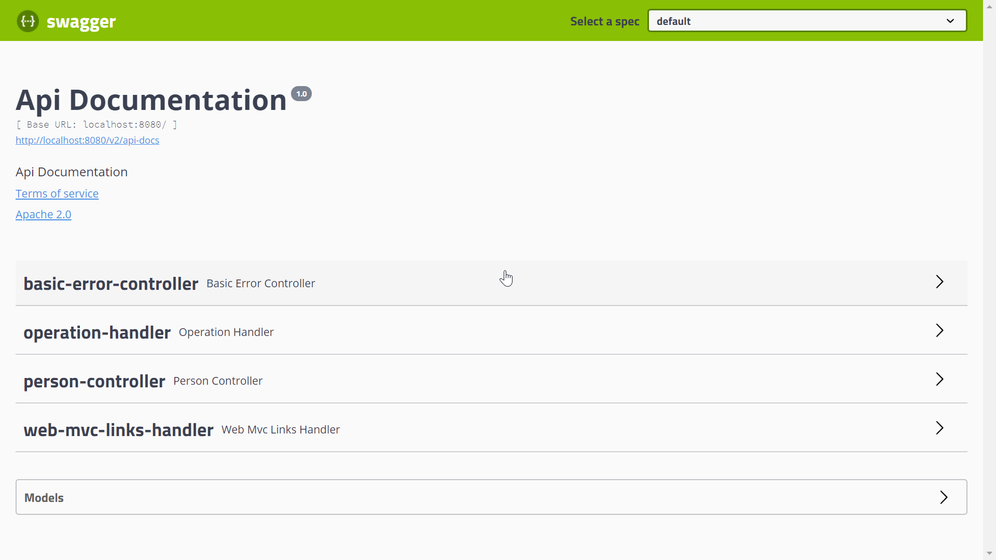

Slide 51



REST
Cucumber
REST
Toxiproxy

Slide 52
Feature: Storage availability scenarios for user service … Background: … Scenario: Read-only mode without MySQL Given 'MySQL' is down When user 'u-12345abde234' is requested Then the user with id 'u-12345abde234' is returned from 'Redis'
Notes:
Agile: simplification
Metrics: simplicity, fast feedback, usability, feature richness

Slide 53
minimize traditional documentation
BDD is not just for e2e tests
“better design” over any documentation

Slide 54

AS CODE
PIPELINE

Slide 55
pipeline { ... stages { stage('checkout') { steps { sh '...' } } stage('test') { steps { ... } } } }

Slide 56
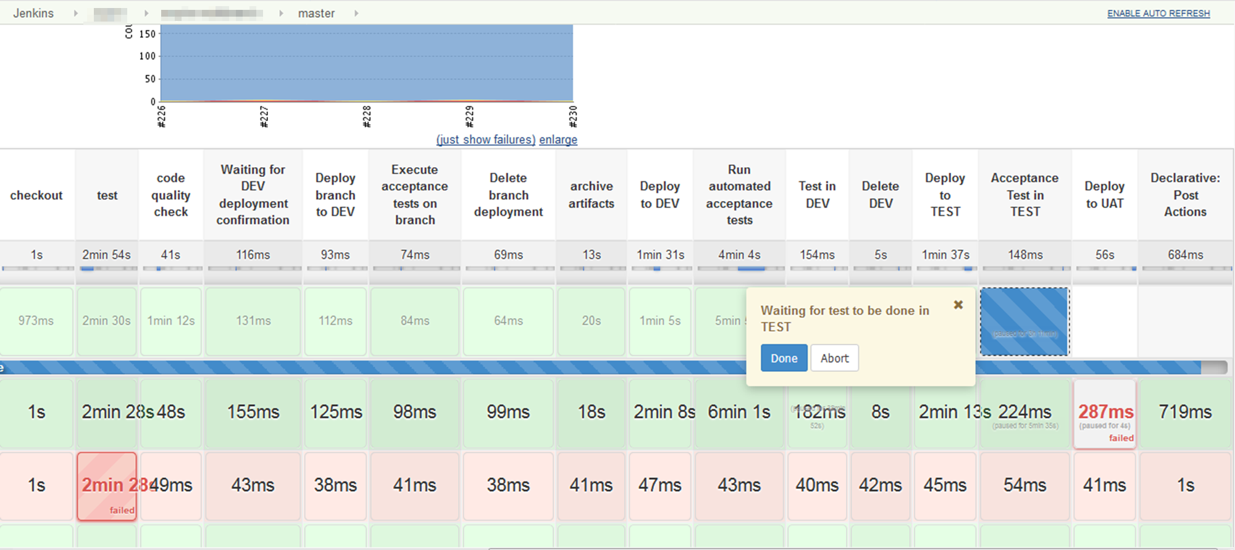
Notes:
Agile: continuous optimization, simplification, small iterations, small experiments, stabilization, baby steps
Metrics: no snowflakes, no S.P.O.F, feature richness, usability, fast feedback, simplicity

Slide 57
feature branches branch deploys
minimize CI/CD complexity !!!
keep pipelines version-controlled

Slide 58


continuous testing
pipeline as code
containers
living documentation
generators
hotswap

Slide 59
principles
practices
tools

Slide 60
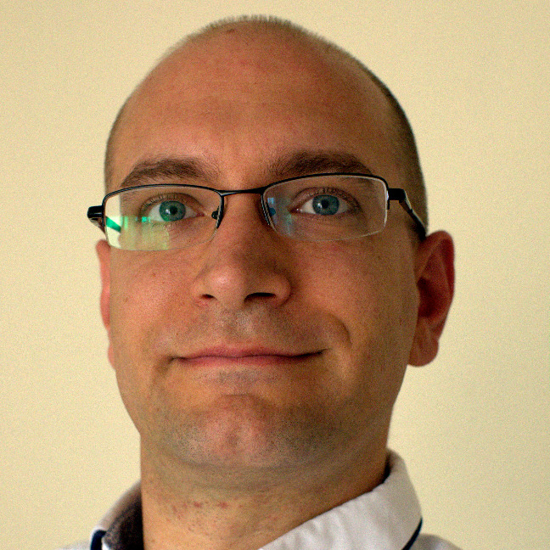




Thank you!
Oresztész Margaritisz
@gitaroktato
gitaroktato
oresztesz_Margaritisz@epam.com
https://www.linkedin.com/in/oresztesz

